Slide 1
KNOWLEDGE INSTITUTE OF TECHNOLOGY DEPARTMENT OF MECHANICAL ENGINEERING
ROBOTICS
K.V.Rangasamy AP/MECH

Slide 2
UNIT I FUNDAMENTALS OF ROBOT
Robot - Definition
Robot Anatomy
Co ordinate Systems, Work Envelope
Types and Classification- Specifications-
Pitch, Yaw, Roll, Joint Notations,
Speed of Motion, Pay Load- Robot Parts and their Functions-
Need for Robots-Different Applications.
MECH-KIOT

Slide 3
ROBOT
“An robot is a programmable, multi-functional manipulator
designed to move materials, parts, tools, or special devices
through variable programmed motions for the performance of
a variety of tasks”
MECH-KIOT

Slide 4
ROBOT LAWS
Three Laws of Robotics:
1.A robot may not injure a human being, or, through inaction, allow a human being to come to harm.
2.A robot must obey the orders given it by human beings except where such orders would conflict with the First Law.
3.A robot must protect its own existence as long as such protection does not conflict with the First or Second Law.
MECH-KIOT

Slide 5
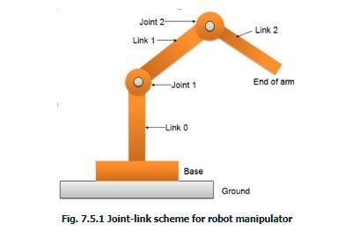
ROBOT ANATOMY
MECH-KIOT

Slide 6
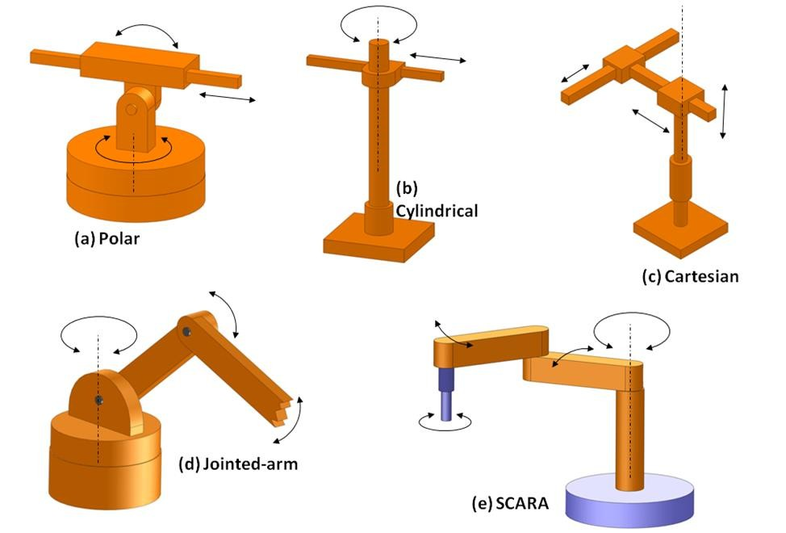
Types and Classification
MECH-KIOT
Basically the robot manipulator has two parts viz. a body-and-arm assembly with three degrees-of-freedom; and a wrist assembly with two or three degrees-of-freedom.
For body-and-arm configurations, different combinations of joint types are possible for a three-degree-of-freedom robot manipulator. Five common body-and-arm configurations are outlined in figure

Slide 7
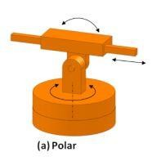
a. Polar configuration
MECH-KIOT
a. Polar configuration
It consists of a sliding arm L-joint, actuated relative to the body, which rotates around both a vertical axis (T-joint), and horizontal axis (R-joint).

Slide 8
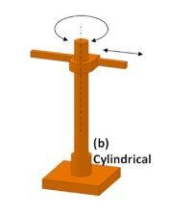
b. Cylindrical configuration
MECH-KIOT
b. Cylindrical configuration
It consists of a vertical column. An arm assembly is moved up or down relative to the vertical column. The arm can be moved in and out relative to the axis of the column. Common configuration is to use a T-joint to rotate the column about its axis. An L-joint is used to move the arm assembly vertically along the column, while an O-joint is used to achieve radial movement of the arm.

Slide 9
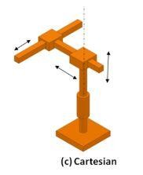
C. Cartesian co-ordinate robot
MECH-KIOT
c. Cartesian co-ordinate robot
It is also known as rectilinear robot and x-y-z robot. It consists of three sliding joints, two of which are orthogonal O-joints.

Slide 10
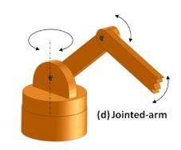
D. Jointed-arm robot
MECH-KIOT
d. Jointed-arm robot
It is similar to the configuration of a human arm. It consists of a vertical column that swivels about the base using a T-joint. Shoulder joint (R-joint) is located at the top of the column. The output link is an elbow joint (another R joint).

Slide 11
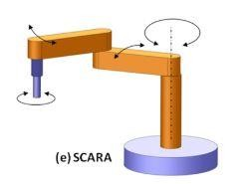
E. SCARA
MECH-KIOT
E. SCARA
Its full form is ‘Selective Compliance Assembly Robot Arm'. It is similar in construction to the jointer-arm robot, except the shoulder and elbow rotational axes are vertical. It means that the arm is very rigid in the vertical direction, but compliant in the horizontal direction.

Slide 12
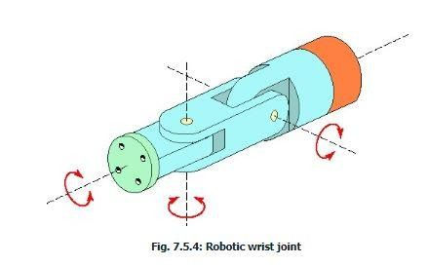
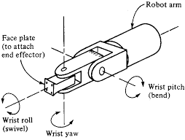
WRIST CONFIGURATION
MECH-KIOT
Robot wrist assemblies consist of either two or three degrees-of-freedom. A typical three-degree-of-freedom wrist joint is depicted in Figure 7.5.4. The roll joint is accomplished by use of a T-joint. The pitch joint is achieved by recourse to an R-joint. And the yaw joint, a right-and-left motion, is gained by deploying a second R-joint.
The SCARA body-and-arm configuration typically does not use a separate wrist assembly. Its usual operative environment is for insertion-type assembly operations where wrist joints are unnecessary. The other four body-and-arm configurations more-or-less follow the wrist-joint configuration by deploying various combinations of rotary joints viz. type R and T.

Slide 13
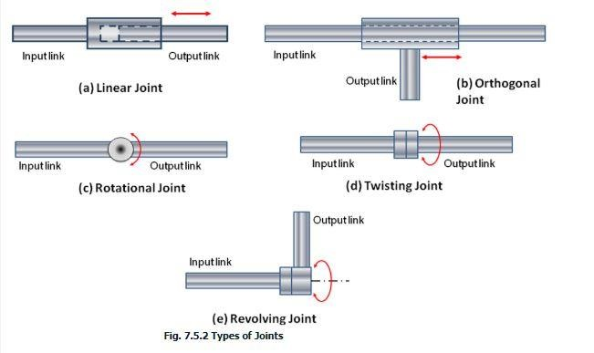
TYPES OF JOINTS
MECH-KIOT

Slide 14
TYPES OF JOINTS
Linear joint (type L joint)
The relative movement between the input link and the output link is a translational sliding motion, with the axes of the two links being parallel.
Orthogonal joint (type U joint)
This is also a translational sliding motion, but the input and output links are perpendicular to each other during the
move.
Rotational joint (type R joint)
This type provides rotational relative motion, with the axis of rotation perpendicular to the axes of the input and output links.
Twisting joint (type T joint)
This joint also involves rotary motion, but the axis or rotation is parallel to the axes of the two links.
Revolving joint (type V-joint, V from the “v” in revolving)
In this type, axis of input link is parallel to the axis of rotation of the joint. However the axis of the output link is
perpendicular to the axis of rotation.
MECH-KIOT

Slide 15
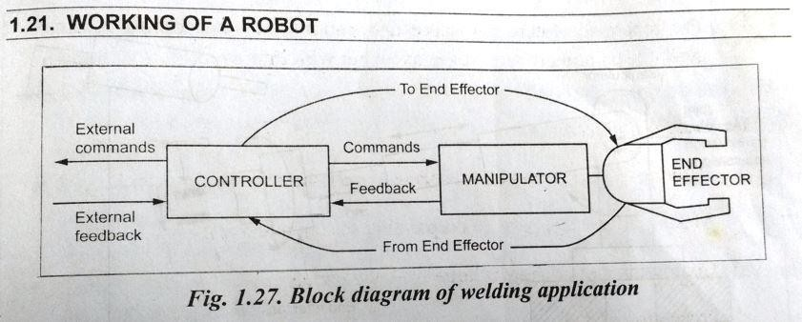
WORKING OF A ROBOT
MECH-KIOT

Slide 16
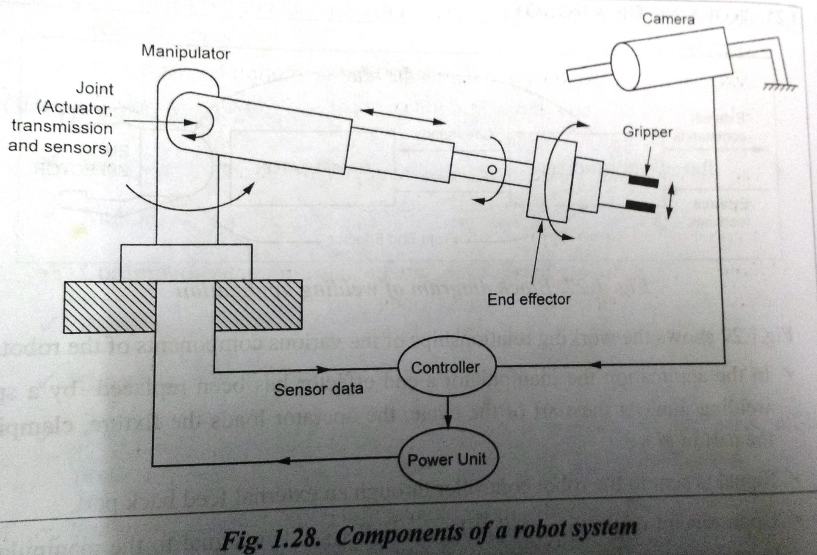
ROBOT COMPONENTS
MECH-KIOT

Slide 17

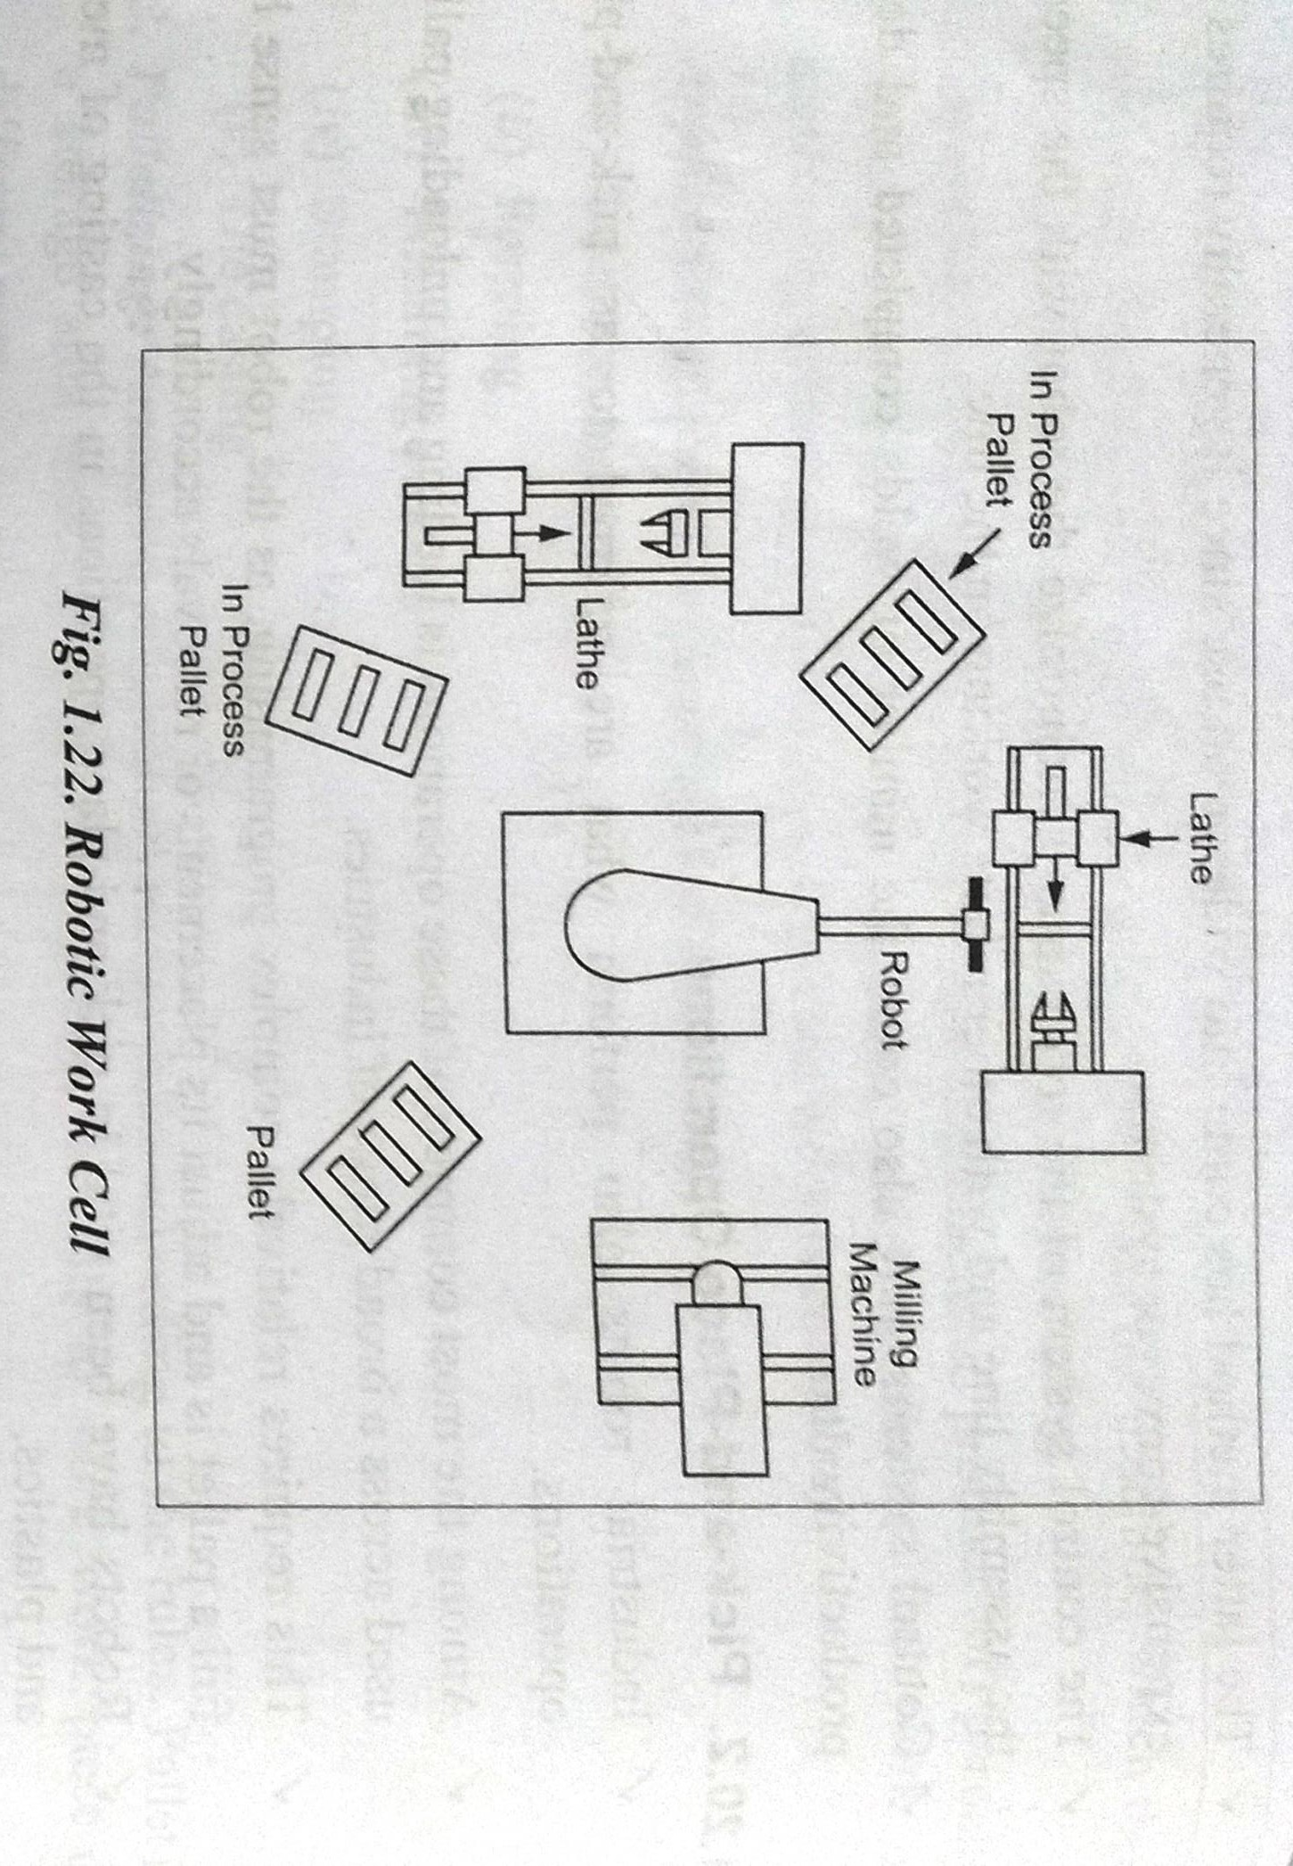
MECH-KIOT

Slide 18
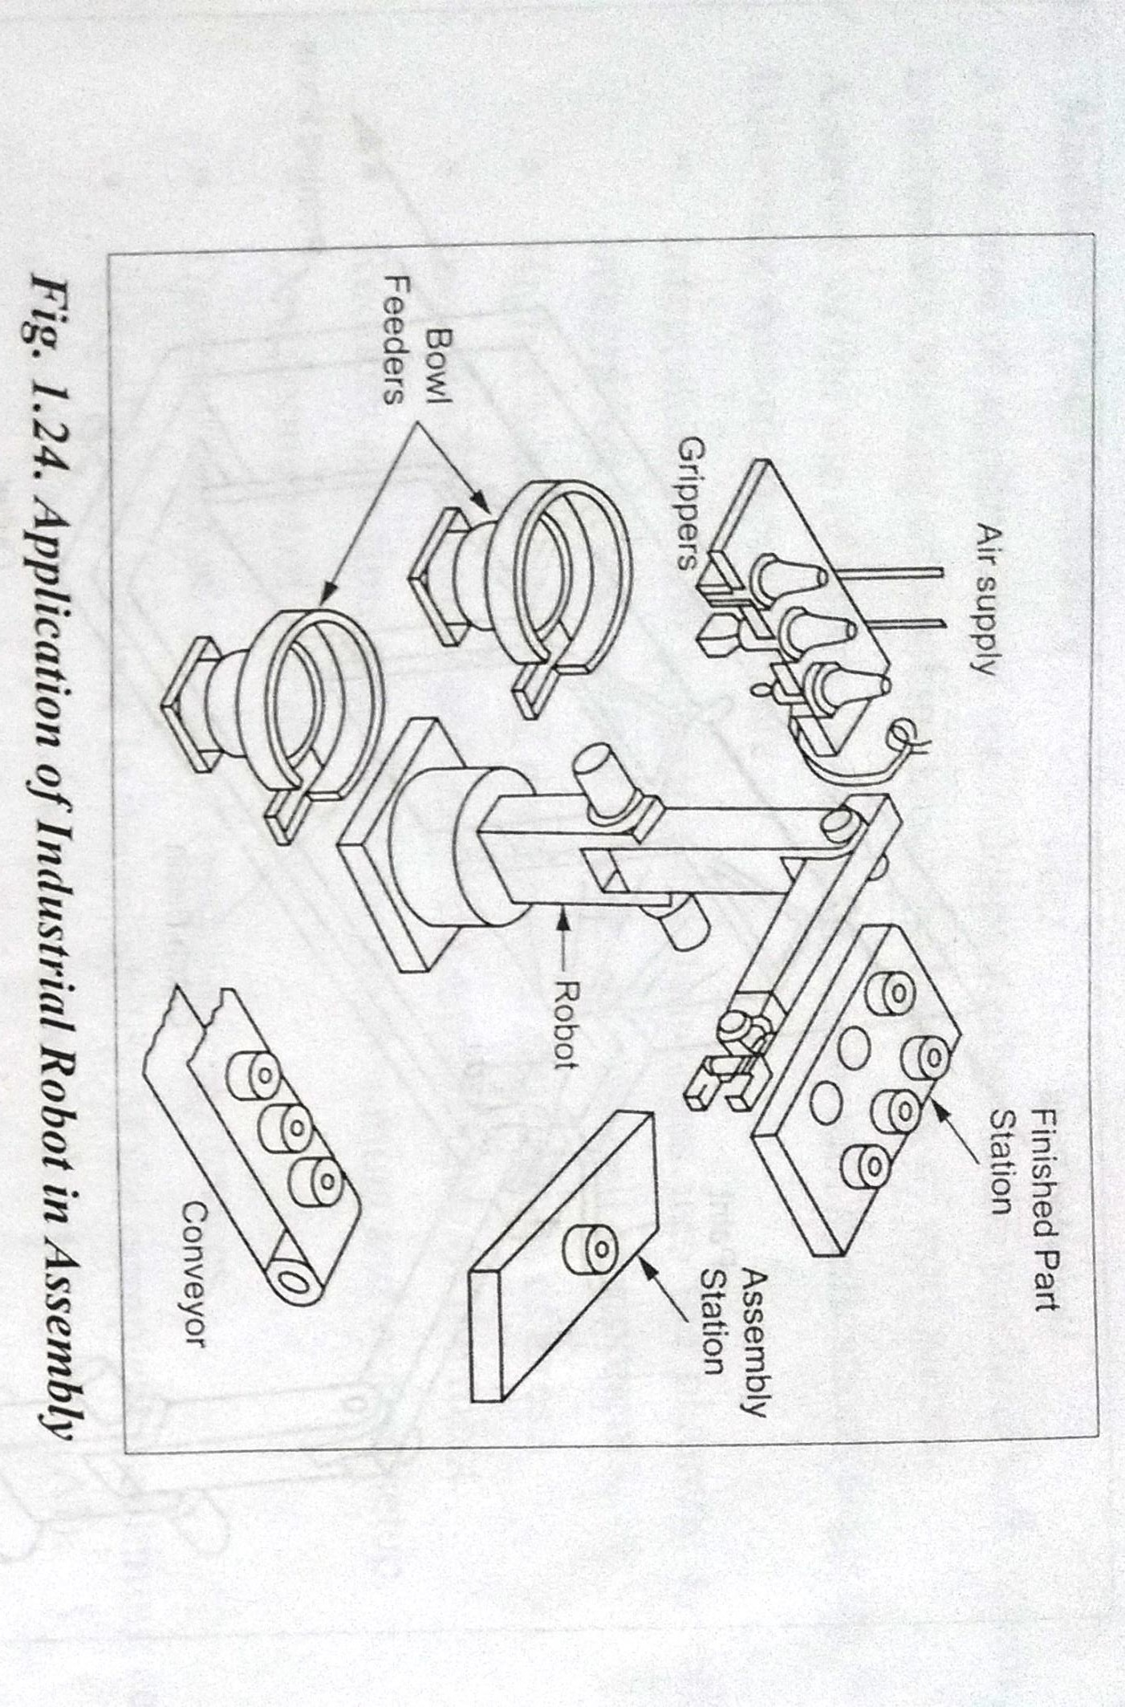
MECH-KIOT

Slide 19
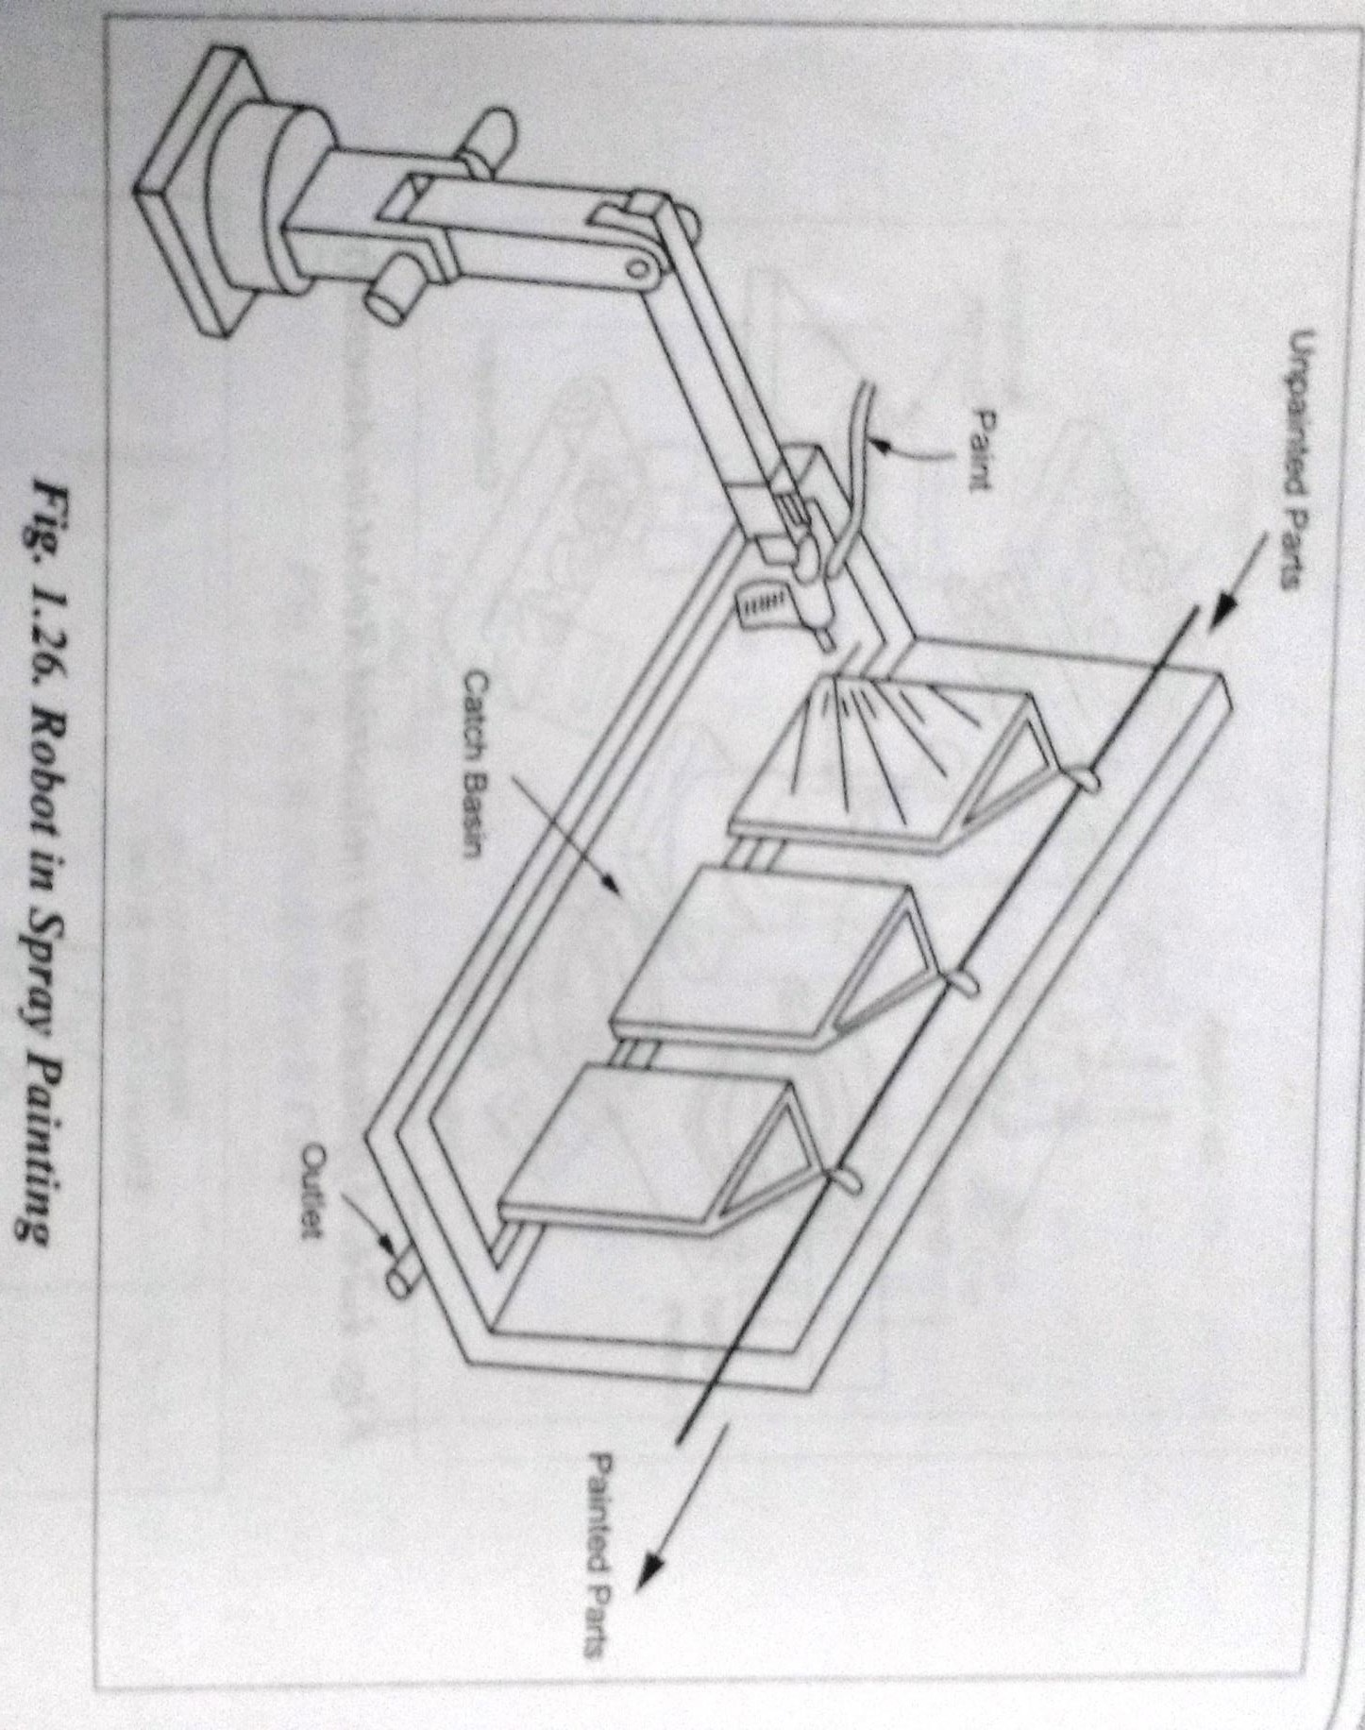
MECH-KIOT

Slide 20
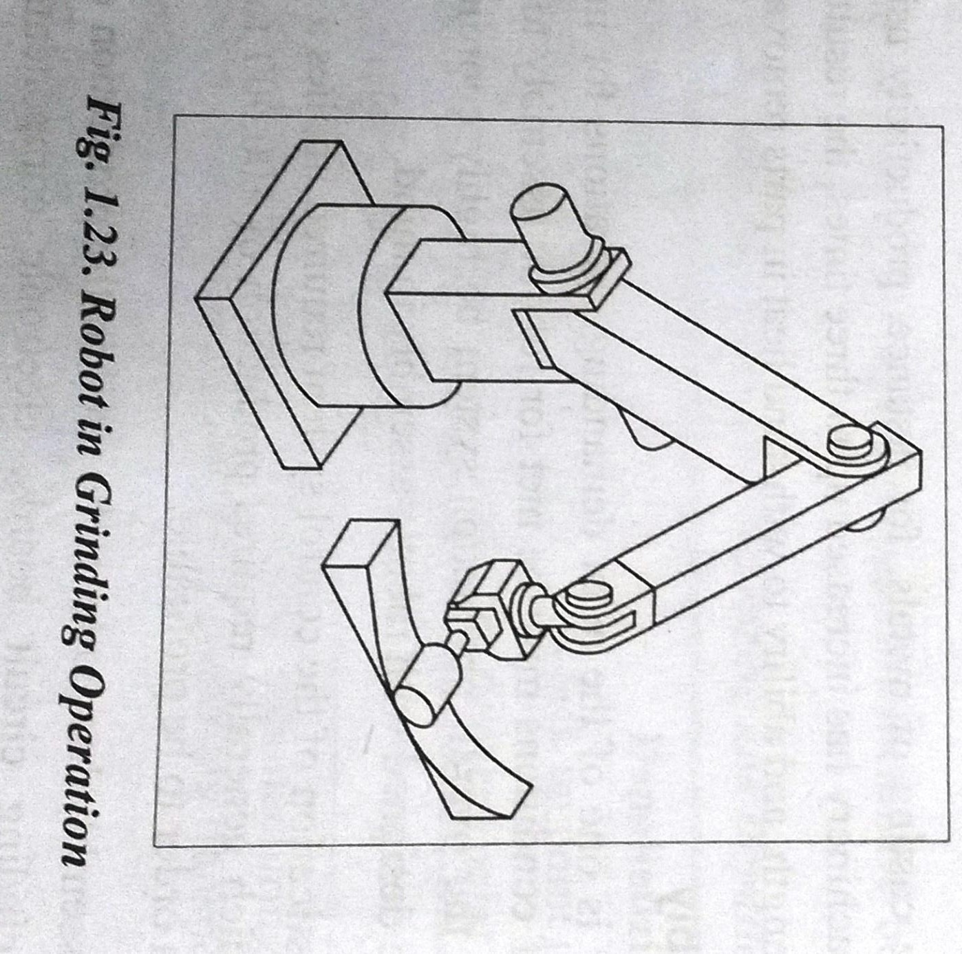
MECH-KIOT

Slide 21
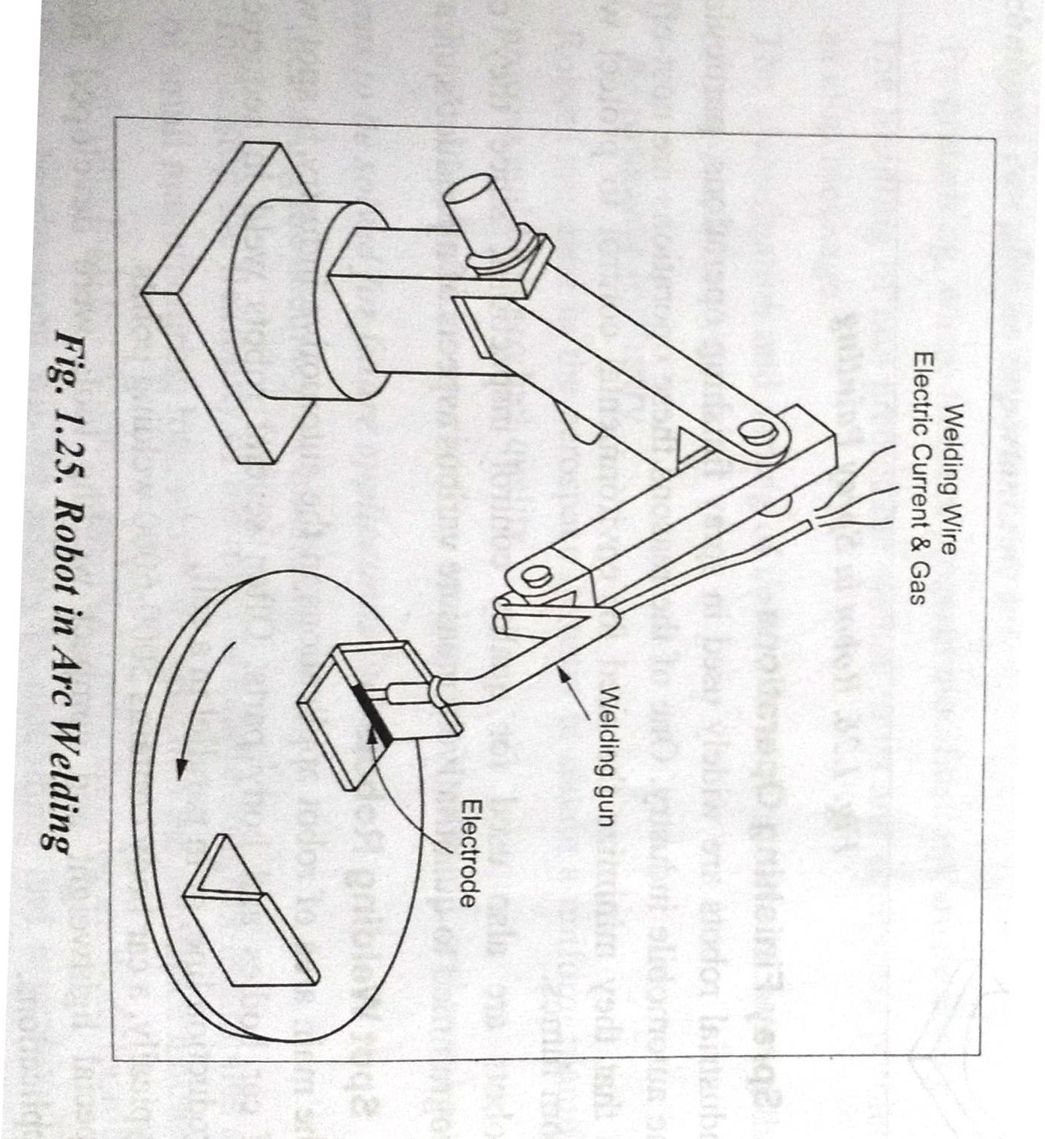
MECH-KIOT

Slide 22
THE NEEDS OF ROBOTS
SPEED (Greater speed)
HAZARDOUS ENVIRONMENT
REPETITIVE TASK (Continue movement)
EFFICIENCY (no waste of time, materials, energy)
ACCURACY ()
ADAPTABILITY
(control changes in car welding areas, ability to work fast, ability to work in hazardous environment, ability to repeat the task again and again)
MECH-KIOT

Slide 23
CLASSIFICATION OF ROBOTS
Physical Configuration
Control system
Movement
Types of drive
Application
Degrees of freedom
Sensory system
Capabilities of Robot Systems
MECH-KIOT

Slide 24
Physical Configuration
  Polar Configuration
  Cylindrical Configuration
  Cartesian Configuration
  Jointed arm Configuration
MECH-KIOT

Slide 25
Control Systems
Point to Point Straight line robot Continuous robot
Movements
Fixed robot Mobile robot
Walking robot or legged robot
MECH-KIOT

Slide 26
Types of drive
Pneumatic Drive Hydraulic drive
Electric drive
Application
Manufacturing Handling Testing
MECH-KIOT

Slide 27
6. Degrees of Freedom
1, 2, 3 six
Sensory system
  Simple and blind robot
  Vision Robot
  Intelligent
Capabilities of Robot Systems
  External Robot control and communication
  System parameters
  Program control
  Control of the end effector
  Program debug and simulation
  Ability to move between points in various ways
MECH-KIOT

Slide 28
Service Industry And Other Applications:
Teaching robots ·
Retail robots ·
Fast-food restaurants ·
Garbage collection in waste disposal operations ·
Cargo handling and loading and distribution operations ·
Security guards ·
Medical care and hospital duties ·
Agricultural robots · House hold robots
MECH-KIOT

Slide 29
UNIT II ROBOT DRIVE SYSTEMS AND END EFFECTORS
Pneumatic Drives-Hydraulic Drives-Mechanical Drives- Electrical Drives-D.C. Servo Motors, Stepper Motors, A.C. Servo Motors-Salient Features, Applications and Comparison of all these Drives,
EndEffectors-Grippers-Mechanical Grippers, Pneumatic and Hydraulic- Grippers, Magnetic Grippers, Vacuum Grippers; Two Fingered and Three Fingered Grippers; Internal Grippers and External Grippers; Selection and Design Considerations.
MECH-KIOT

Slide 30
End Effectors & Grippers

Slide 31
End Effectors
An end effector is usually attached to the robot's wrist, and it allows the robot to accomplish a specific task.
This means that end effectors are generally custom- engineered and fabricated for each different operation.
There are two general categories of end effectors viz. grippers and tools.
MECH-KIOT

Slide 32
Mechanical gripper
A mechanical gripper is used as an end effector in a robot for grasping the objects with
its mechanically operated fingers.
In industries, two fingers are enough for holding purposes. More than three fingers can also be used based on the application. As most of the fingers are of replaceable type, it can be easily removed and replaced.
MECH-KIOT

Slide 33
In a mechanical gripper, the holding of an object can be done by two different methods such as:
Using the finger pads as like the shape of the work part.
Using soft material finger pads.
MECH-KIOT

Slide 34
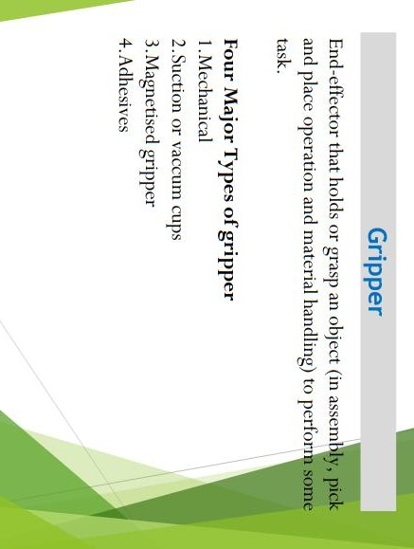
MECH-KIOT

Slide 35
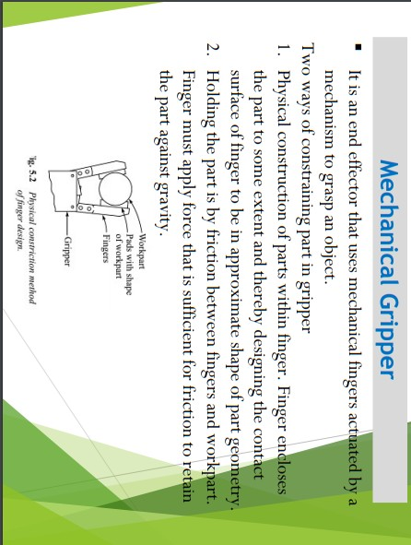
MECH-KIOT

Slide 36
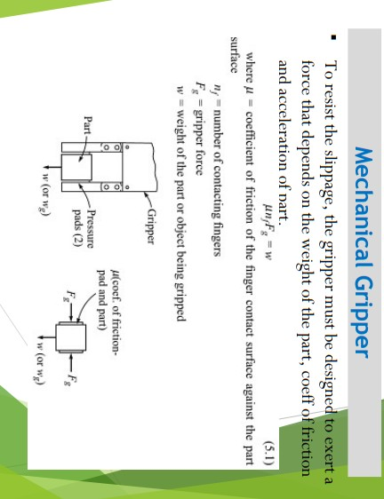
MECH-KIOT

Slide 37
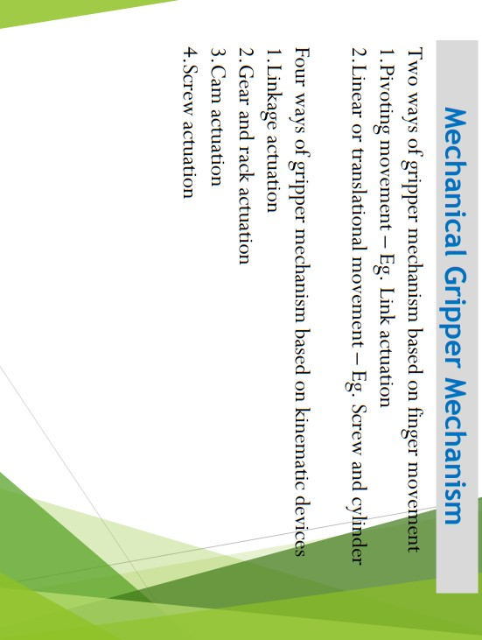
MECH-KIOT

Slide 38
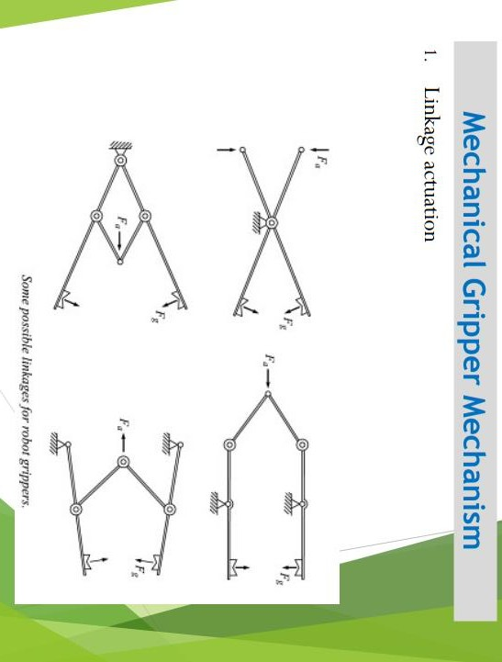
MECH-KIOT

Slide 39
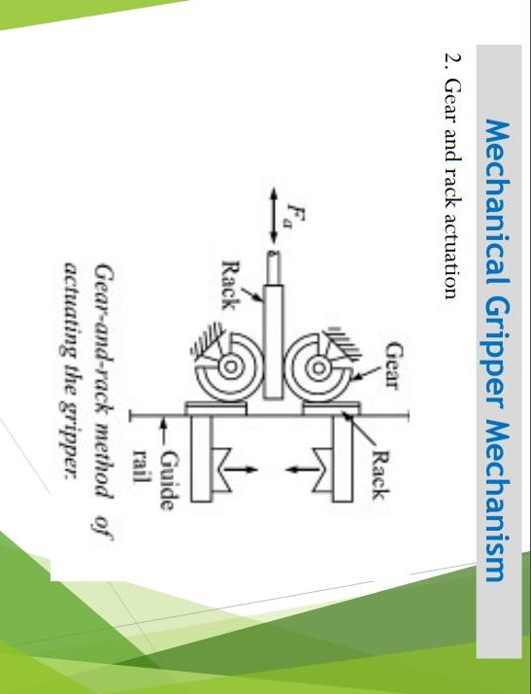
MECH-KIOT

Slide 40
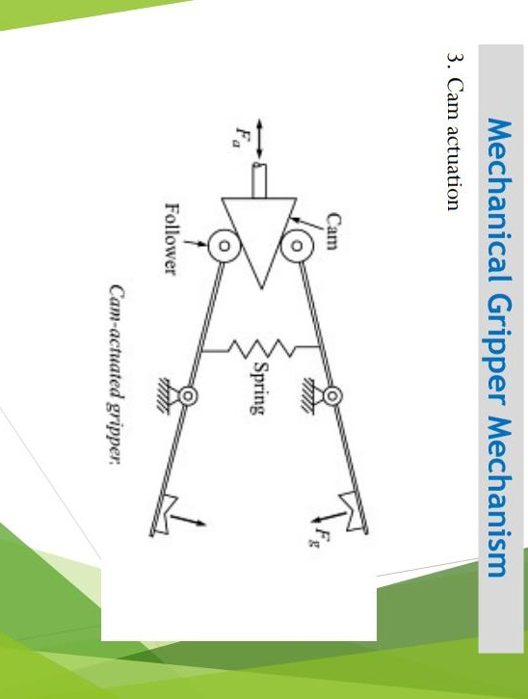
MECH-KIOT

Slide 41
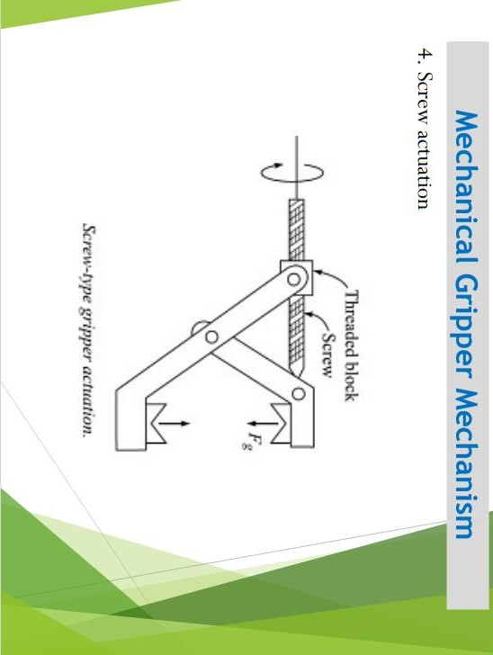
MECH-KIOT

Slide 42
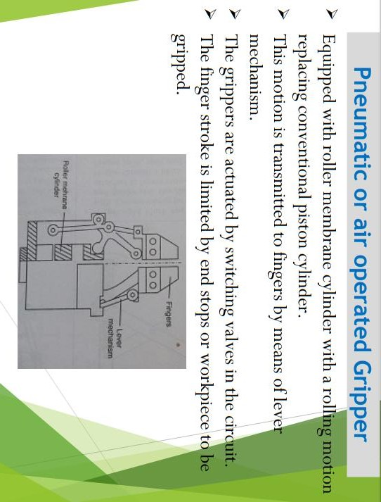
MECH-KIOT

Slide 43
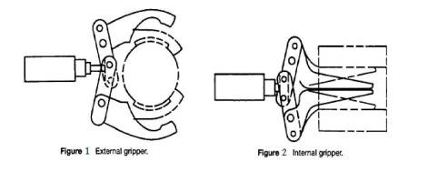
Internal & External Grippers
MECH-KIOT

Slide 44
In the first method, the contact surfaces of the fingers are designed according to the work part for achieving the estimated shape. It will help the fingers to hold the work part for some extent.
In the second method, the fingers must be capable of supplying sufficient force to hold the work part. To avoid scratches on the work part, soft type pads are fabricated on the fingers.
MECH-KIOT

Slide 45
As a result, the contact surface of the finger and co – efficient of friction are improved. This method is very simple and as well as less expensive. It may cause slippage if the force applied against the work part is in the parallel direction. The slippage can be avoided by designing the gripper based on the force exerted.
µ n_{f} F_{g} = w ………………… 1
µ => co – efficient of friction between the work part and fingers
n_{f} => no. of fingers contacting
F_{g} => Force of the gripper
w => weight of the grasped object
The equation 1 must be changed if the weight of a work part is more than the force applied to cause the slippage.
µ n_{f} F_{g} = w g …..……………. 2
g => g factor
During rapid grasping operation, the work part will get twice the weight. To get rid out of it, the modified equation 1 is put forward by Engelberger. The g factor in the equation 2 is used to calculate the acceleration and gravity.
The values of g factor for several operations are given below:
g = 1 – acceleration supplied in the opposite direction.
g = 2 – acceleration supplied in the horizontal direction.
g = 3 – acceleration and gravity supplied in the same direction.
MECH-KIOT

Slide 46
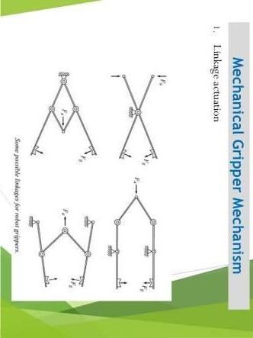
MECH-KIOT

Slide 47
Screw actuation:
The screw-type actuated gripper consists of a screwconnected with a threaded block. To rotate the screw, a motor is used along with a speed reduction device. If the screw is turned in one direction, the threaded block is moved in one direction. Similarly, the threaded block moves in the opposite direction if the screw is turned on the other direction. As the threaded block is attached with gripper, it makes the fingers to open and close.
MECH-KIOT

Slide 48
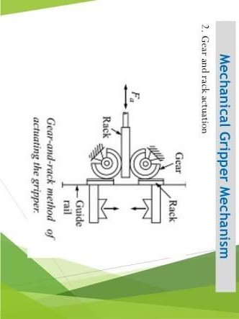
MECH-KIOT

Slide 49
Gear and rack actuation:
For this actuation, the gear and rack are connected with
a piston, which provides linear-type movement. The two partial pinion gears are driven when the rack is moved. As it is linked with gripper, the opening and closing of fingers are accomplished.
MECH-KIOT

Slide 50
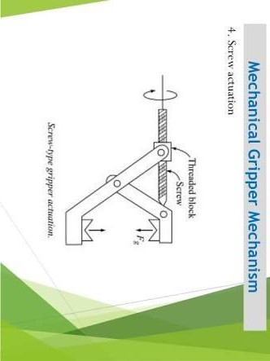
MECH-KIOT

Slide 51
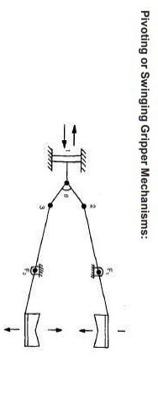
MECH-KIOT

Slide 52
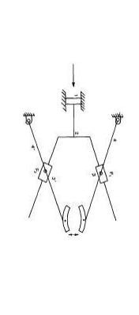
MECH-KIOT

Slide 53
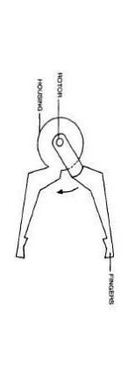
MECH-KIOT

Slide 54
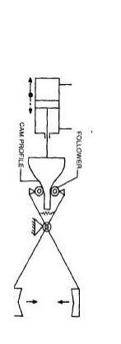
MECH-KIOT

Slide 55
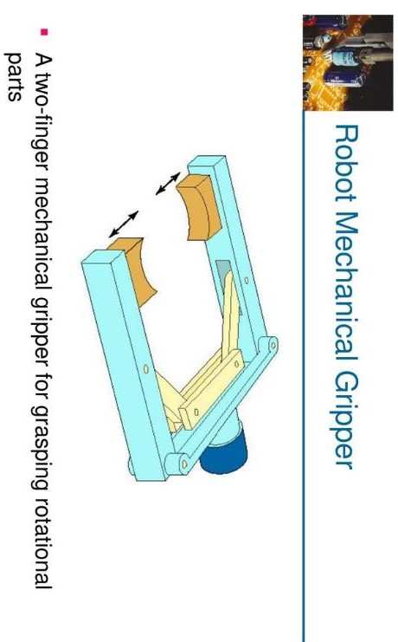
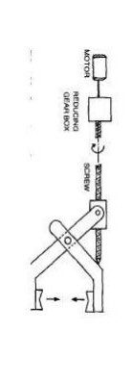
MECH-KIOT

Slide 56
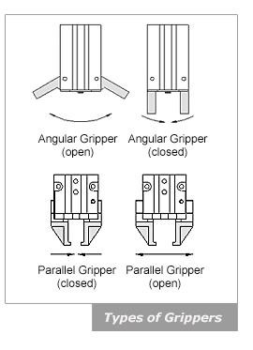
Pneumatic Grippers
MECH-KIOT

Slide 57
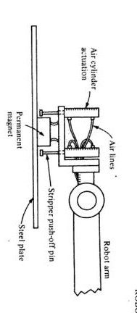
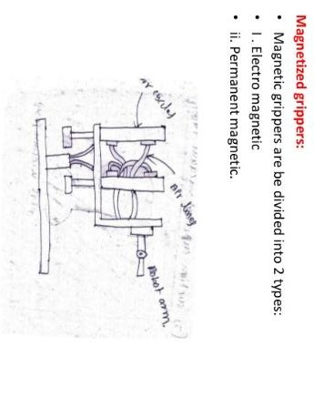
MECH-KIOT

Slide 58
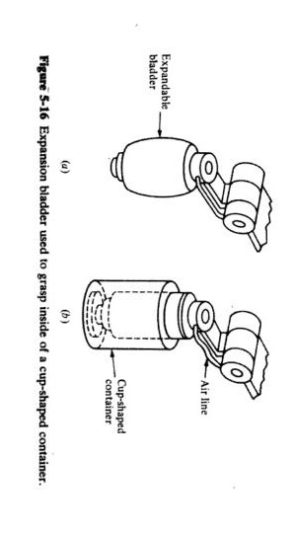
MECH-KIOT

Slide 59
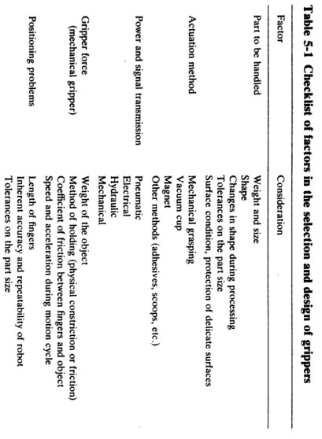
MECH-KIOT

Slide 60
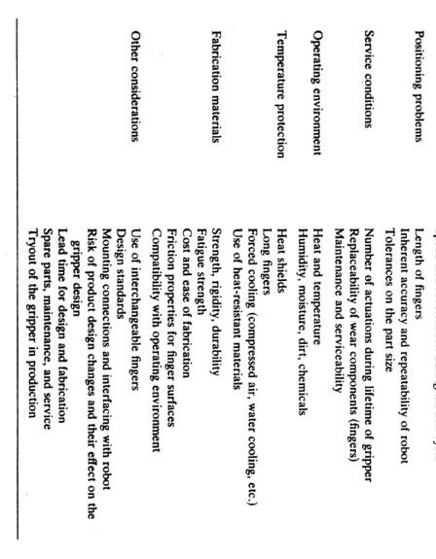
MECH-KIOT

Slide 61
The drive:
The drive is the engine that moves the articulations into their designated positions. The joints are the sections between the parts of the robot. The following types of units are:
hydraulic, electric, or pneumatic.
Hydraulic drive systems give a robot great speed and strength.
Electric system provides a robot with less speed and strength.
Pneumatic drive systems are used for smaller robots that have fewer axes of
movement.
MECH-KIOT

Slide 62
Cam actuation
As like linkage actuated gripper, it also has a wide range of designs for opening and closing the gripper fingers. One of its types is described shortly here. A cam actuated gripper with spring loaded follower can be used to provide open and close actions of fingers. The spring is incorporated for forcing the gripper to close if the cam is moved in one direction, while the movement of cam on the other direction causes the gripper to open. This type can be useful for holding various sizes of work parts.
MECH-KIOT

Slide 63
Rope and pulley actuation:
In this actuation, a tension device is required to go up against the rope movement in the pulley. Suppose, if the pulley is activated in one direction for opening the gripper, the tension device will provide slack in the rope. Similarly, the gripper is closed by activating the pulley on the other direction.
MECH-KIOT

Slide 64
Additionally, some mechanisms come under miscellaneous types. An important one is diaphragm or expandable bladder, which is inflated or deflated to open and close the fingers.
MECH-KIOT

Slide 65
Pneumatic Grippers
The most popular types of pneumatic grippers are the 2 jaw parallel and 2 jaw angular gripper styles. Parallel grippers open and close parallel to the object that it will be holding, these are the most widely used grippers. They are the simplest to tool and can compensate for some dimensional variation.
Angular grippers move the jaws in a radial manner to rotate the jaws away from the object and therefore require more space. There are also 3 jaw and toggle style grippers that are designs for more specific handling requirements.
MECH-KIOT

Slide 66
Hydraulic Grippers
Grippers are devices used with pick-and-place robotic systems to pick up or
place an object on an assembly line, conveyor system, or other automated system. Fingered tooling—or jaws—is attached to the grippers to grip or hold the object.
Three common types are parallel, three-finger, and angled designs. The most common are parallel designs, with two fingers that close on a workpiece to grip it or open it out by creating pressure on the inside. Three- finger designs hold the workpiece in the center, and have three fingers offset by 120°. Finally, angled designs feature jaws that work at a variety of different angle openings (for example, 30°, 40°, etc.).
MECH-KIOT

Slide 67
In general, hydraulic and pneumatic grippers have the same basic actuation principle. They include direct acting piston designs as well as piston wedge designs.
The direct acting piston design is used when a hydraulic force acts directly on a piston that is directly connected to the jaw or finger that is touching or gripping the part.
MECH-KIOT

Slide 68
The piston wedge design features a hydraulic force acting on a piston while the piston itself is acting on a wedge. The wedge translates this force to the jaws or fingers, providing the grip force to grip the part.
The wedge can give a mechanical advantage as it can increase grip force while keeping the piston diameter and pressure to the piston the same. This allows more grip force in a smaller package compared to the directing piston.
MECH-KIOT

Slide 69
In addition, three choices of power are available; the most common being pneumatic grippers; electromechanical grippers are second most common; and the least common being hydraulic grippers. Hydraulic grippers are most often used in conjunction with a piece of equipment that only has a hydraulic power source for actuators.
MECH-KIOT

Slide 70
When selecting a hydraulic gripper, it is important to consider the following:
Part weight and size to be lifted
Part material
Clearance issues around the part that could interfere with the gripping
part
The environment the gripper will be used in (corrosive, food or beverage, etc.)
The motion path of the robot or linear device that is moving the gripper
The power supply that will be available and the pressure ratings available
MECH-KIOT

Slide 71
There are different types of robot end effectors. The most common are pneumatic grippers, because they are simple and low cost. Nowadays, a new player has entered the game and it is the electric gripper. This kind of gripper allows the user to control precisely the speed and position of the end effector. Suction cups are even more simple gripping devices since they use vacuum to lift flat objects. Then comes the magnetic gripper. This gripper is often forgotten in grippers lists, so we decided to expose you to its characteristics.
MECH-KIOT

Slide 72
Magnetic end effector types
Electromagnets
Grippers using electromagnets are generally powered by DC power for handling material. This type of magnetic end effector is easy to control because the attraction can be turned off by shutting down the current. This can also help to remove the magnetism of the handled part.
MECH-KIOT

Slide 73
Permanent Magnets
These kinds of end effectors do not need power to operate. They are always on. In order to separate the piece from the magnet, a push-off pin is included on the end effector. The permanent magnet offers an advantage when it comes to safety, since the gripper remains on even if a blackout occurs. Moreover, there is no possibility of generating sparks during production since no electric current is required.
MECH-KIOT

Slide 74
Top 5 advantages
It only needs one surface to grab the object.
The grasping speed is fast.
It is flexible since it does not need different designs for different parts.
It can grip parts with holes which is not possible with vacuum grippers.
It requires minimal maintenance.
Top 5 disadvantages
When moved quickly, the part can slip out of the end effector.
Just a little oil on the surface can reduce the strength of the end effector.
Machining chips can stay on the gripper when unloading the piece.
Handled parts can stay magnetised.
It can only be used with ferromagnetic material.
•
Different end effectors exist to fit any application in the industry. Manufactures just have to find the best fit for their needs, in order to do the job efficiently with the best ROI.
MECH-KIOT

Slide 75
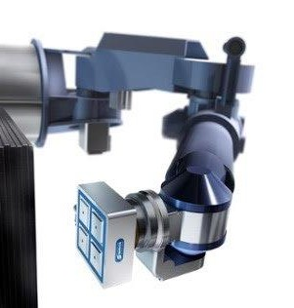
MECH-KIOT

Slide 76
Vacuum grippers are used in the robots for grasping the non – ferrous objects. It uses vacuum cups as the gripping device, which is also commonly known as suction cups. This type of grippers will provide good handling if the objects are smooth, flat, and clean. It has only one surface for gripping the objects. Most importantly, it is not best suitable for handling the objects with holes.
MECH-KIOT

Slide 77
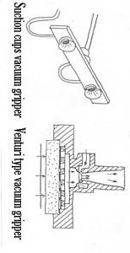
MECH-KIOT

Slide 78
Vacuum cups:
Generally, the vacuum cups (suction cups) will be in the round shape. These cups will be developed by means of rubber or other elastic materials. Sometimes, it is also made of soft plastics. Moreover, the vacuum cups are prepared of hard materials for handling the soft material objects.
Two different devices are used in the suction cups for creating the vacuum. They are:
Venturi
Vacuum pump
Venturi device is operated with the help of shop air pressure, while the vacuum pump is driven either by means of vane or piston device. The vacuum pump has the ability to create the high vacuum. As the venturi is a simple device, it is more reliable and inexpensive. Both these devices are very well capable of providing high vacuum if there is a sufficient supply of air pressure.
MECH-KIOT

Slide 79
Types of vacuum grippers:
The ball joint type vacuum gripper is capable of changing into various contact angles automatically. Moreover, the bending moments in the vacuum cups are also decreased. It is used for carrying irregular materials, heavy objects, etc.
A vacuum gripper with level compensator can be very helpful in balancing the objects with different levels. It also has the capability to absorb the shocks.
Applications of vacuum grippers:
Vacuum grippers are highly useful in the heavy industries, automobiles, compact disc
manufacturing, and more for material handlingpurposes.
It is also used in the tray & box manufacturing, labeling, sealing, bottling, and so on for packagingpurposes.
MECH-KIOT

Slide 80
Sensors Used in Robot

Slide 81
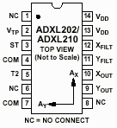

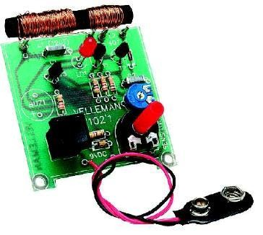


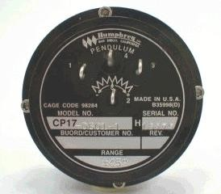


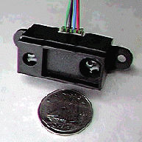




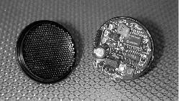

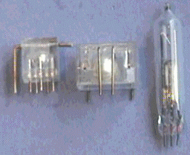



















Accelerometer
Gyro
Gas Sensor
Pendulum Resistive Tilt Sensors
Metal Detector
Piezo Bend Sensor
Gieger-Muller Radiation Sensor
Pyroelectric Detector
UV Detector
Resistive Bend Sensors
CDS Cell Resistive Light Sensor
Digital Infrared Ranging
Pressure Switch
MECH-KIOT
Limit Switch
Miniature Polaroid S
ensor
Mechanical Tilt Sensors
Touch Switch
IR Pin Diode
IR Sensor w/lens
Thyristor
Magnetic Sensor
Hall Effect Magnetic Field Sensors
Polaroid Sensor Board
IR Reflection
Sensor
IR Amplifier Sensor
Magnetic Reed Switch
IRDA Transceiver
Lite-On IR
Remote Receiver
Radio Shack Remote Receiver
IR Modulator Receiver
Solar Cell
Compass
Compass
Piezo Ultrasonic Trans
ducers

Slide 82
Sensors used in robot navigation
Resistive sensors
  bend sensors, potentiometer, resistive photocells, ...
Tactile sensors
  contact switch, bumpers…
Infrared sensors
  Reflective, proximity, distance sensors…
Ultrasonic Distance Sensor
Inertial Sensors (measure the second derivatives of position)
  Accelerometer, Gyroscopes,
Orientation Sensors
  Compass, Inclinometer
Laser range sensors
Vision
Global Positioning System
MECH-KIOT

Slide 83
Classification of Sensors
Internal state (proprioception) v.s. external state (exteroceptive)
  feedback of robot internal parameters, e.g. battery level, wheel position, joint angle, etc,
  observation of environments, objects
Active v.s. non-active
  emitting energy into the environment, e.g., radar, sonar
  passively receive energy to make observation, e.g., camera
Contact v.s. non-contact
Visual v.s. non-visual
  vision-based sensing, image processing, video camera
MECH-KIOT

Slide 84
Robotic Sensor Classification
In general, robotic sensors can be divided into two classes:
  Internal state sensors - device being used to measure the position, velocity and acceleration of the robot joint and/or end-effector. These devices are potentiometer, tachometers, synchros, resolvers, differential transformers, optical interrupters, optical encoders and accelerometer.
  External state sensors – device being used to monitor the relationship between the robot kinematics and/or dynamics with its task, surrounding, or the object being manipulated.
MECH-KIOT

Slide 85
Sensor Selection/Sensing Taxonomy
There are many different types of robot sensors available and there are
many different parameter measured by these sensors.
The application process, should be carried out in a top down manner, starting with task requirements, and going through several levels of analysis, eventually leading to the selection of a specific device.
A taxonomy for sensing to aid this process consists of five levels of refinement leading to sensor selection:
•
MECH-KIOT
Specification of task requirements :eg localization, slippage detection, size confirmation, inspection, defect testing.
Choice of modality :eg,vision, force, tactile
Specification on sensor attributes :eg,output, complexity, discrete or continuous variable, imaging or non-imaging, local or global
Specification of operational parameters :eg size, accuracy, cost
Selection of mechanism :eg switching devices, inductive sensors, CCD vision
imaging

Slide 86
Primary physical mechanisms employed in sensors:
Some typical sensor operational data:
Ultrasonics
Resistive Effects
Capacitive Efects
Piezo-Electric Effects
Visible Light Imaging
Photo-Electric & Infrared
Mechanical Switching
Inductive Effects
Thermal Effects
Hall Effect
Cost Range Accuracy
Repeatability
Power Requirements Output Signal Specification Processing Reuirements Sensitivity
Reliability Weight Seze
MECH-KIOT

Slide 87
SENSORS FOR INDUSTRIAL ROBOT
S
Proximity and Range Sensors Tactile Sensors
Vision Sensors
Miscellaneous Sensors

Slide 88
I
It is a technique of detecting the presence or absence of an object with electronic noncontact sensors.
Typical application of proximity sensors includes:
ש Object detection
ש Collision avoidance
ש Object verification & counting
Commonly available proximity sensors are:
  Photoelectric/optical sensors
  Inductive proximity sensors
  Capacitive proximity sensors
  Ultrasonic proximity sensors
MECH-KIOT

Slide 89

Resistive Sensors
Bend Sensors
Resistance = 10k to 35k
As the strip is bent, resistance increases
Resistive Bend Sensor
Potentiometers
Can be used as position sensors for
sliding mechanisms or rotating shafts
Easy to find, easy to mount
Potentiometer
MECH-KIOT
Light Sensor (Photocell)
Good for detecting direction/presence of light
Non-linear resistance
Slow response to light changes
Photocell
R is small when brightly illuminated

Slide 90






Applications
Sensor
Measure bend of a joint
Wall Following/Collision Detection
Sensors
MECH-KIOT
Weight Sensor
Sensor

Slide 91
Infrared Sensors
Intensity based infrared
  Reflective sensors
  Easy to implement
  susceptible to ambient light
Modulated Infrared
  Proximity sensors
  Requires modulated IR signal
  Insensitive to ambient light
Infrared Ranging
  Distance sensors
  Short range distance measurement
  Impervious to ambient light, color and reflectivity of object
MECH-KIOT

Slide 92

Intensity Based Infrared
Break-Beam sensor
Reflective Sensor
MECH-KIOT
Increase in ambi raises DC bias
ent light
voltage
Easy to implement (few components)
Works very well in controlled environments
Sensitive to ambient light
time
voltage
time

Slide 93

IR Reflective Sensors
Reflective Sensor:
  Emitter IR LED + detector photodiode/phototransistor
  Phototransistor: the more light reaching the phototransistor, the more current passes through it
  A beam of light is reflected off a surface and into a detector
  Light usually in infrared spectrum, IR light is
Applications:
  Object detection,
  Line following, Wall tracking
  Optical encoder (Break-Beam sensor)
Drawbacks:
  Susceptible to ambient lighting
    Provide sheath to insulate the device from outside lighting
  Susceptible to reflectivity of objects
  Susceptible to the distance between sensor and the object
invisible
MECH-KIOT

Slide 94

Modulated Infrared
Modulation and Demodulation
  Flashing a light source at a particular frequency
  Demodulator is tuned to the specific frequency of light flashes. (32kHz~45kHz)
  Flashes of light can be detected even if they are very week
  Less susceptible to ambient lighting and reflectivity of objects
  Used in most IR remote control units, proximity sensors
MECH-KIOT
Negative true
logic:
Detect = 0v
v
No detect = 5

Slide 95

IR Proximity Sensors
amplifier bandpass filter integrator
limiter demodulator comparator
Proximity Sensors:
  Requires a modulated IR LED, a detector module with built-in modulation decoder
  Current through the IR LED should be limited: adding a series resistor in LED driver circuit
  Detection range: varies with different objects (shiny white card vs. dull black object)
  Insensitive to ambient light
Applications:
  Rough distance measurement
  Obstacle avoidance
  Wall following, line following
MECH-KIOT

Slide 96


IR Distance Sensors
Basic principle of operation:
  IR emitter + focusing lens + position-sensitive detector
MECH-KIOT
Modulated IR light
Location of the spot on the detector corresponds to the distance to the target surface, Optics to covert horizontal distance t vertical distance
o

Slide 97
IR Distance Sensors
Sharp GP2D02 IR Ranger
  Distance range: 10cm (4") ~ 80cm (30").
  Moderately reliable for distance measurement
  Immune to ambient light
  Impervious to color and reflectivity of object
  Applications: distance measurement, wall following, …
MECH-KIOT

Slide 98
Range Finder
(Ultrasonic, Laser)

Slide 99

Range Finder
Time of Flight
The measured pulses typically come form ultrasonic, RF and optical energy sources.
  D = v * t
  D = round-trip distance
  v = speed of wave propagation
  t = elapsed time
Sound = 0.3 meters/msec
RF/light = 0.3 meters / ns (Very difficult to measure short distances 1-100
meters)
MECH-KIOT

Slide 100

Ultrasonic Sensors
Basic principle of operation:
  Emit a quick burst of ultrasound (50kHz), (human hearing: 20Hz to 20kHz)
  Measure the elapsed time until the receiver indicates that an echo is detected.
  Determine how far away the nearest object is from the sensor
D = v * t
D = round-trip distance
v = speed of propagation(340 m/s) t = elapsed time
Bat, dolphin, …

Slide 101

Ultrasonic Sensors
MECH-KIOT
Ranging is accurate but bearing has a 30 degree uncertainty. The object can be located anywhere in the arc.
Typical ranges are of the order of several centimeters to 30 meters.
Another problem is the propagation time. The ultrasonic signal will take 200 msec to travel 60 meters. ( 30 meters roundtrip @ 340 m/s )

Slide 102

Ultrasonic Sensors
Polaroid ultrasonic ranging system
  It was developed for auto-focus of cameras.
  Range: 6 inches to 35 feet
Transducer Ringing:
Ultrasonic
transmitter + receiver @ 50 KHz
Residual vibrations or ringing may be interpreted as the echo signal
Blanking signal to block any return signals for the first 2.38ms after transmission
Electronic board
transducer
http://www.acroname.com/robotics/info/articles/sonar/sonar.html

Slide 103

Operation with Polaroid Ultrasonic
The Electronic board supplied has the following I/0
  INIT : trigger the sensor, ( 16 pulses are transmitted )
  BLANKING : goes high to avoid detection of own signal
  ECHO : echo was detected.
  BINH : goes high to end the blanking (reduce blanking time <
2.38 ms)
BLNK : to be generated if multiple echo is required
t
MECH-KIOT

Slide 104
Ultrasonic Sensors
Applications:
  Distance Measurement
  Mapping: Rotating proximity scans (maps the proximity of objects surrounding the robot)
Doorway
MECH-KIOT
Length of Echo
Robot
chair
chair
Scan moving from left to right
Scanning at an angle of 15º apart can achieve best results

Slide 105

Noise Issues
MECH-KIOT

Slide 106

Laser Ranger Finder
Range 2-500 meters
Resolution : 10 mm
Field of view : 100 - 180 degrees
Angular resolution : 0.25 degrees
Scan time : 13 - 40 msec.
These lasers are more immune to Dust and Fog
MECH-KIOT
http://www.sick.de/de/products/categories/safety/

Slide 107


Tactile sensing includes any form of sensing which requires physical touching between the sensor and the object to be sense.
The need for touch or tactile sensors occurs in many robotic applications, from picking oranges to loading machines. Probably the most important application currently is the general problem of locating, identifying, and organizing parts that need to be assembled.
Tactile sensor system includes the capability to detect such things as:
Presence
Part shape, location, orientation, contour examination
Contact are pressure and pressure distribution
Force magnitude, location, and direction
Surface inspection : texture monitoring, joint checking, damage detection
Object classification : recognition, discrimination
Grasping : verification, error compensation (slip, position ,orientati
Assembly monitoring
MECH-KIOT
on)

Slide 108
The major components of a tactile/touch
sensor system are:
  A touch surface
  A transduction medium, which convert local forces or moments into electrical signals.
  Structure
  Control/interface
MECH-KIOT

Slide 109


Resistive
It is the transduction method in tactile sensor design which has received the most attention. It is concerned with the change in resistance of a conductive material under applied pressure.
MECH-KIOT
This technique involves measuring the resistance either through or across the thickness of a conductive elastomer. Most elastomers are made from carbon- or silicon-doped rubber.
Resistive Tactile Element – Resistance Measured Through The rubber

Slide 110

1. Wide dynamic range
Advantages:
Durability
Good overload tolerance
Compatibility with integrated
circuitry, particularly VLSI.
Disadvantages:
  Hysteresis in some designs.
  Elastromer needs to be optimized for both mechanical and electrical properties.
  Limited spatial resolution compared with vision sensors.
  Larger numbers of wires may have
to be brought away from the sensor.
  Monotonic response but often not linear.
MECH-KIOT
Resistive Tactile Element –
Resistance Measured Across the rubber

Slide 111


Piezoelectric & Pyroelectric Effects
Piezoelectric effect is the generation of a voltage across a sensing element when pressure applied to it. The voltage generate is proportionally related to the applied pressure. No external voltage is required, and a continuous analogue output is available from such sensor.
A pyroelectric effect is the generation of a voltage when the sensing element is heated or cooled.
Polymeric materials with piezoelectric and pyroelectric properties are appropriate for us with sensors.
d
e
MECH-KIOT
Piezoelectric/Pyroelectric Effects Tactile element

Slide 112
Advantages:
  Wide dynamic range
  Durability
  Good mechanical properties of piezoelectric from pyroelectric materials
  Temperature as well as force sensing capabilities
Disadvantages:
  Difficult of separating piezoelectric from pyroelectric effects
  Inherently dynamic - output decay to zero for constant load
  Difficult of scanning elements
  Good solution are complex
MECH-KIOT

Slide 113
CAPACITIVE TECHNIQUE
Tactile sensors within this category are concerned with measuring
capacitance, which made to vary under applied load.
The capacitance of a parallel plate capacitor depends upon the separation of the plates and their area, so that a sensor using an elastomeric separator between the plates provides compliance such that the capacitance will vary according to applied load.
MECH-KIOT

Slide 114

MECH-KIOT
Capacitive Tactile Element

Slide 115
Advantages:
  Wide dynamic range
  Linear response
  Robust
Disadvantages:
  Susceptible to noise
  Some dielectrics are temperature sensitive
  Capacitance decreases with physical size ultimately limiting
spatial resolution.
MECH-KIOT

Slide 116

Transduction
A Linear Potentiometer
Advantages:
Well known Technology
Good for probe application
Disadvantages:
Limited spatial resolution
Complex for array construct
MECH-KIOT
ion
Mechanical Transducer A linear Potentiometer

Slide 117

Magnetic Transduction Methods
Sensors using magnetic transduction are divided into two basic categories:
Groups together sensors which use mechanical movement to produce change in magnetic flux.
Advantages:
Wide dynamic range
Large displacements possible
Simple
Disadvantages:
Poor spatial resolution
Mechanical problems when
MECH-KIOT
sensing on slopes.
Magnetic tactile Element

Slide 118

2. Concerns magnetoelastic materials which show a change in magnetic field when subjected to mechanical stress.
Advantages:
Wide dynamic range
Linear response
Low hysteresis
Robust
Disadvantages:
Susceptible to stray field and noise.
A.C. circuit required
MECH-KIOT
Magneto resistive tactile Element

Slide 119

Optical Transduction Methods
Advantages:
Very high resolution
Compatible with vision sensing technology
No electrical interference problems
Processing electronics can
be remote from sensor
Low cabling requirements
Disadvantages:
Dependence on elastomer in some designs – affects robustness
Some hysteresis
MECH-KIOT
Optical Tactile Element
Pressure to light Transduction

Slide 120


Vision is the most powerful robot sensory capabilities. Enables a robot to have a sophisticated sensing mechanism that allows it to respond to its environment in intelligent and flexible manner. Therefore machine vision is the most complex sensor type.
Robot vision may be defined as the process of extracting, characterizing, and interpreting information from images of a three-dimensional world. This process, also known as machine or computer vision may be subdivided into six principle areas. These are:
Sensing : the process that yields visual image
Preprocessing : deals with techniques such as noise reduction and enhancement of details
Segmentation : the process that partitions an image into objects of
interest
Description: deals with that computation of features for example size or shape, suitable for differentiating one type of objects from another.
Recognition: the process that identifies these objects (for example
wrench, bolt, engine block, etc.)
Interpretation: assigns meaning to an ensemble of recognized objects.
MECH-KIOT
1.
2.
3.
4.
5.
6.

Slide 121
IMAGING COMPONENTS
The imaging component, the “eye” or sensor, is the first link in the vision chain. Numerous sensors may be used to observe the world. There are four type of vision sensors or imaging components:
1. Point sensors
capable of measuring light only at a single point in space. These sensor using coupled with a light source (such as LED) and used as a noncontact ‘feeler’
It also may be used to create a higher – dimensions set of vision Information by scanning across a field of view by using mechanisms such as orthogonal set of scanning mirrors
MECH-KIOT

Slide 122

T
KIO
-
CH
E
M
Noncontact feeler-point sensor

Slide 123

T
KIO
-
CH
E
M
Image scanning using a point sensor and oscillating deflecting mirrors

Slide 124

2. Line Sensor
Line sensors are one-dimensional devices used to collect vision information from a real scene in the real world.
The sensor most frequently used is a “line array” of photodiodes or charger-couple-device components.
It operates in a similar manner to analog shift register, producing sequential, synchronized output of electrical signals, corresponding to the light intensity falling on an integrated light-collecting cell.
MECH-KIOT
Circular and cross configurations
of light sensors

Slide 125

An automated robot sorting
system using
a line scan camera to generate two-dimensional images.
MECH-KIOT
Line array may be used to image scene. E.g. by fixing the position of a straight-line sensor and moving an object orthogonally to the orientation of the array, one may scan the entire object of interest.

Slide 126
3. Planar Sensor
A two dimensional configuration of the line-scan concept. Two generic types of these sensors generally in use today are scanning photomultipliers and solid-state sensors.
Photomultipliers are represented by television cameras, the most common of which is the vidicon tube, which essentially an optical- to-electrical signal converter.
In addition to vidicon tubes, several types of solid-state cameras are available. Many applications require the solid-state sensors because of weight and noise factor (solid-state arrays are less noisy but more expensive). This is important when mounting a camera near or on the end-effector of a robot.
MECH-KIOT

Slide 127

4. Volume Sensor
A sensor that provide three- dimensional information. The sensor may obtain the information by using the directional laser or acoustic range finders.
MECH-KIOT
Schematic representation of a triangulation range finder

Slide 128
IMAGE REPRESENTATION
From the diagram below. F(x,y) is used to denote the two- dimensional image out of a television camera or other imaging device.
“x” and “y” denote the spatial coordinates (image plane)
“f” at any point (x,y) is proportional to the brightness (intensity) of
the image at that point.
In form suitable for computer processing, an image function f(x,y) must be digitized both spatially and in amplitude (intensity). Digitization of the spatial coordinates (x,y) will be known as image sampling, while amplitude digitization is known as intensity or grey- level quantization.
The array of (N, M) rows and columns, where each sample is sampled uniformly, and also quantized in intensity is known as a digital image. Each element in the array is called image element, picture element (or pixel).
MECH-KIOT

Slide 129

d size.
Effects of reducing sampling gri
a) 512x512.
b) 256x256.
c) 128x128.
d) 64x64.
e) 32x32.
MECH-KIOT

Slide 130


Effect produced by reducing the number of intensity levels while maintaining the spatial resolution constant at 512x512. The 256-, 128- and 64-levels are of acceptable quality.
a) 256, b) 128, c) 64, d) 32, e) 16, f) 8, g) 4, and h) 2 levels
MECH-KIOT

Slide 131
ILLUMINATION TECHNIQUES
Illumination of a scene is an important factor that often affects the
complexity of vision algorithms.
A well designed lighting system illuminates a scene so that the complexity of the resulting image is minimised, while the information required for object detection and extraction is enhanced.
Arbitrary lighting of the environment is often not acceptable because it can result in low contras images, specular reflections, shadows and extraneous details.
There are 4 main illumination techniques for a robot work space :
MECH-KIOT

Slide 132


ILLUMINATION TECHNIQUES
DIFFUSE-LIGHTING
  This technique is for smooth, regular
surface object. It is used where surface characteristic are important.
  Example:
MECH-KIOT
Diffuse-lighting technique

Slide 133


ILLUMINATION TECHNIQUES
BACKLIGHTING
  Produce black and white image. This technique suited for applications in which silhouettes of object are sufficient for recognition or other measurement.
  Example:
MECH-KIOT
Backlighting technique

Slide 134


ILLUMINATION TECHNIQUES
3. STRUCTURED LIGHTING
Consist of projecting points, stripes, grids onto work surface.
This lighting technique has 2
important advantages:
It establishes a known light pattern on the work space and disturbances of this indicate the presence of an object, thus simplifying the object detection problems.
By analysing the way which the light pattern distorted, it is possible to gain insight into three-dimensional characteristics of the object.
MECH-KIOT
Structured lighting technique

Slide 135

3. STRUCTURED LIGHTING (cont.)
(a) Top view of two light planes intersecting in a line sight
The following figure illustrates the structured lighting technique using two light planes projected from different directions, but converging on a single stripe on the surface. The two light sources guarantee that the object will break the light stripe only when it is directly below the camera.
This technique is suitable for moving
object.
Note: “The line scan camera sees only the line on which the two light planes converge, but two-dimension information can be accumulated as the object move past the camera”
(b) Object will be seen by the camera only When it interrupts both light planes
MECH-KIOT

Slide 136

LUMINATION TECHNIQUES
DIRECTIONAL LIGHTING
This method is used to inspection of
object surfaces.
Defects on the surface such as scratches, can be detected by using a highly directed light beam (such as laser beam) and measuring the amount of scatter
MECH-KIOT
Directional lighting technique

Slide 137

ROBOT VISION SYSTEM
There are several commercial packages that can be bought for vision processing work. A typical hardware configuration is shown below.
Based on the technique used, the robotic vision systems can be grouped into the
following major types:
Binary vision systems
Gray-level vision systems
Ad hoc special-purpose vision systems
Structured light vision systems
Character recognition vision systems
MECH-KIOT
Vision system hardware

Slide 138
A typical system will have facilities for controlling the camera remotely and perhaps interfaces for remote lighting control.
The main problem with commercial vision packages is that they have to be general purpose in order to be applicable in many situations. This very requirement sometimes means that they are not suitable or are over complicated for a particular robot task in hand.
In industrial robot world, vision is not used in an exploratory sense but is used to confirm or measure or refine existing known data.
Whichever commercial vision system one purchases, one is likely to use it for
applications such as those listed in the next section.
MECH-KIOT

Slide 139

Vision Dev. Tools: Survey
Commercial products
  Matrox: MIL, Inspector
  Coreco Imaging: Sapera, MVTools, WiT
  MVTec: Halcon
  Euresys: eVision, EasyAccess
  AAI: Aphlion
Free tools
  Intel: Open Source Computer Vision
  Microsoft: Vision SDK
  XMegaWave: XMegaWave
  UTHSCSA: ImageTool
MECH-KIOT
Slide borrowed from CAIRO

Slide 140
VISION APPLICATIONS
1. OBJECT LOCATION
Used in object handling and processing:
-Position -Orientation
2. OBJECT PROPERTIES
Used in inspection, identification, measurement:
-Size
-Shape
-Texture
-Area
-Periphery length / area ratio
-Repetition of pattern
-Properties of internal features
3. SPATIAL RELATIONS
Used in measurement and task verification
-Relative positions
-Relative orientations -Occlusions
-Alignments -Connectivity
4. ACTION MONITORING
Used in actuator control and verification:
MECH-KIOT
-Direct feedback
-Action confirmation
-Error measurement
-Inspection
-Collision avoidance planning.

Slide 141
MISCELLANEOUS SENSORS
POSITION, VELOCITY& ACCELERATION SENSORS
There are several type of sensor that can be used to determine the position of robot joints like potentiometer, optical encoder, Linear Variable Differential Transformer (LVDT) Force & Torque Sensors.
MECH-KIOT

Slide 142

Potentiometer
Potentiometer transducers can be used to measure both linear and angular displacement
MECH-KIOT
Potentiometer
(b) Schematic diagram of the potentiometer

Slide 143

Linear Variable Differential Transformer (LVDT)
LDVT is a robust and precise device which produce a voltage output proportional to the displacement of a ferrous armature for measurement of robot joints or end-effectors. It is much expensive but outperforms the potentiometer transducer.
MECH-KIOT
Linear Variable Differential Transformer (LVDT)

Slide 144

Force & Torque Sensors
Force transducers are often based on displacement principl There various type force and torque transducer available commercially
A force-measuring device based on a compression spring and LDVT.
es.
MECH-KIOT

Slide 145

T
KIO
-
CH
E
M
This figure illustrate a tension load cell.
It can be used to measure the force
required to pick up heavy load in industry

Slide 146

Force & Torque Sensors
Force can be measured using piezoelectric principle.
Figure shows a load washer type piezoelectric force transducer. It is designed to measure axial forces. It is preloaded when manufactured and can measure both tensile and compressive forces.
MECH-KIOT

Slide 147

Force & Torque Sensors
Measured using piezoelectri
principle.
Figure shows a three- component dynamometer type piezoelectric force transducer that measures three orthogonal componen of force.
c
ts
MECH-KIOT

Slide 148
Motor Encoder

Slide 149



Incremental Optical Encoders
Incremental Encoder:
light sensor
direction
resolution
decode circuitry
light emitter
grating
It generates pulses proportional to the rotation speed of the shaft.
Direction can also be indicated with a two phase encoder:
A
MECH-KIOT
B
A leads B

Slide 150



Absolute Optical Encoders
Used when loss of reference is not possible.
Gray codes: only one bit changes at a time ( less uncertainty).
The information is transferred in parallel form (many wires are necessary).
Binary |  | Gray Code
000 |  | 000
001 |  | 001
010 |  | 011
011 |  | 010
100 |  | 110
101 |  | 111
110 |  | 101
111 |  | 100
MECH-KIOT

Slide 151


Other Odometry Sensors
Resolver
It has two stator windings positioned at 90 degrees. The output voltage is proportional to the sine or cosine function of the rotor's angle. The rotor is made up of a third winding, winding C
MECH-KIOT
Potentiometer
= varying resistance

Slide 152
Inertial Sensors
Gyroscopes
  Measure the rate of rotation independent of the coordinate frame
  Common applications:
    Heading sensors, Full Inertial Navigation systems (INS)
Accelerometers
  Measure accelerations with respect to an inertial frame
  Common applications:
    Tilt sensor in static applications, Vibration Analysis, Full INS Systems
MECH-KIOT

Slide 153
Accelerometers
They measure the inertia force generated when a mass is
affected by a change in velocity.
This force may change
  The tension of a string
  The deflection of a beam
  The vibrating frequency of a mass
MECH-KIOT

Slide 154

Accelerometer
Main elements of an accelerometer:
1. Mass 2. Suspension mechanism 3. Sensing element
d ² x dx
d ²t dt
MECH-KIOT
F = m
c + kx
High quality accelerometers include a servo loop to improve the linearity of the sensor.

Slide 155

Gyroscopes
These devices return a signal proportional to the rotational velocity.
There is a large variety of gyroscopes that are based on different principles
MECH-KIOT

Slide 156


Global Positioning System (GPS)
24 satellites (+several spares)
broadcast time, identity, orbital
parameters (latitude, longitude, altitude)
MECH-KIOT
Space Segment
http://www.cnde.iastate.edu/staff/swormley/gps/gps.ht

Slide 157
Global Positioning System (GPS)
24 satellites (+several spares)
broadcast time, identity, orbital
parameters (latitude, longitude, altitude)
MECH-KIOT
Space Segment
http://www.cnde.iastate.edu/staff/swormley/gps/gps.ht

Slide 158
Noise Issues
Real sensors are noisy
Origins: natural phenomena + less-than-ideal engineering
Consequences: limited accuracy and precision of measurements
Filtering:
  software: averaging, signal processing algorithm
  hardware tricky: capacitor
MECH-KIOT

